Slide 1
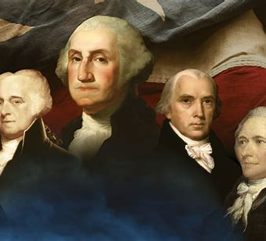

The impact of faith on America’s founding at our 250th anniversary
Dr. Peter a. Lillback
Westminster theological seminary
June 6, 2026

Slide 2
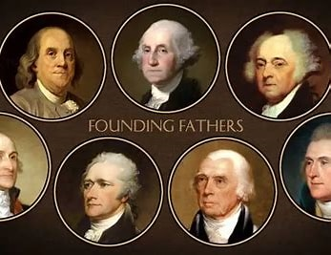

There are many founding fathers
We will consider only a few.
And there may be some you didn’t expect.

Slide 3
Early American History
A timeline of important events at America’s Founding
1682-1789
[1682-1684; 1699-1701]
William Penn in Philadelphia
[1739-40]
George Whitefield’s first visits to Philadelphia
[1765]
Stamp Act
[1776]
Declaration of Independence
[1787-1789]
US Constitution

Slide 4
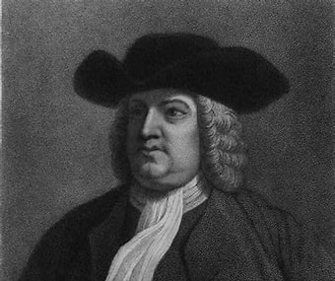
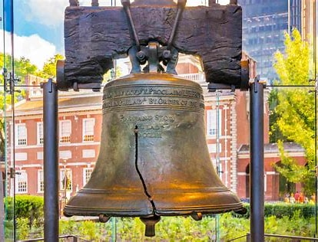
William Penn establishes Pennsylvania and Philadelphia
Penn Names His City
Who Is Our State Named for?
Charter of Privileges (1701)
Liberty Bell (1751)

Slide 5
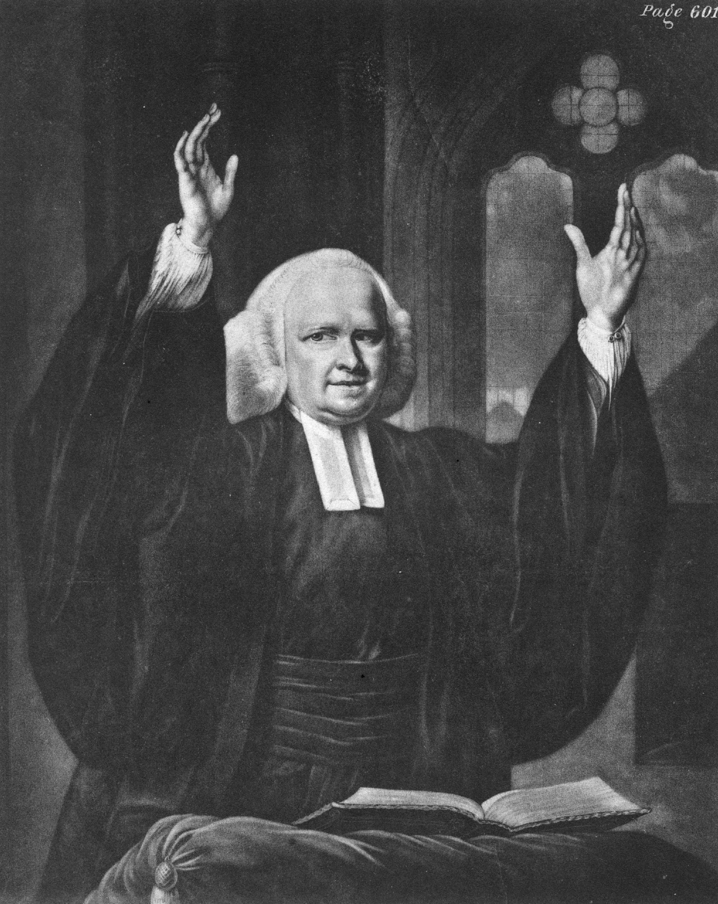
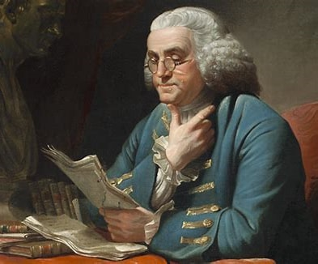
Evangelist George whitefield
The Great Awakening
Benjamin Franklin

Slide 6
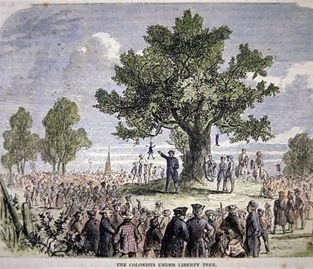
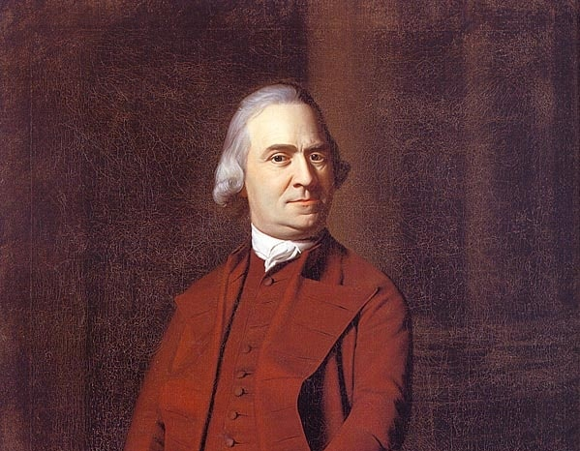
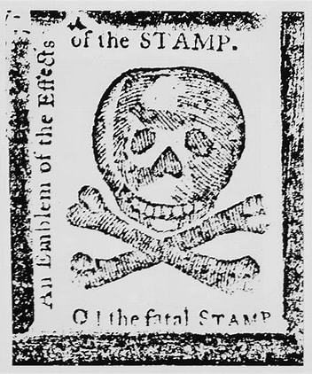
Samuel adams: the stamp act, the sons of liberty, the liberty tree

Slide 7
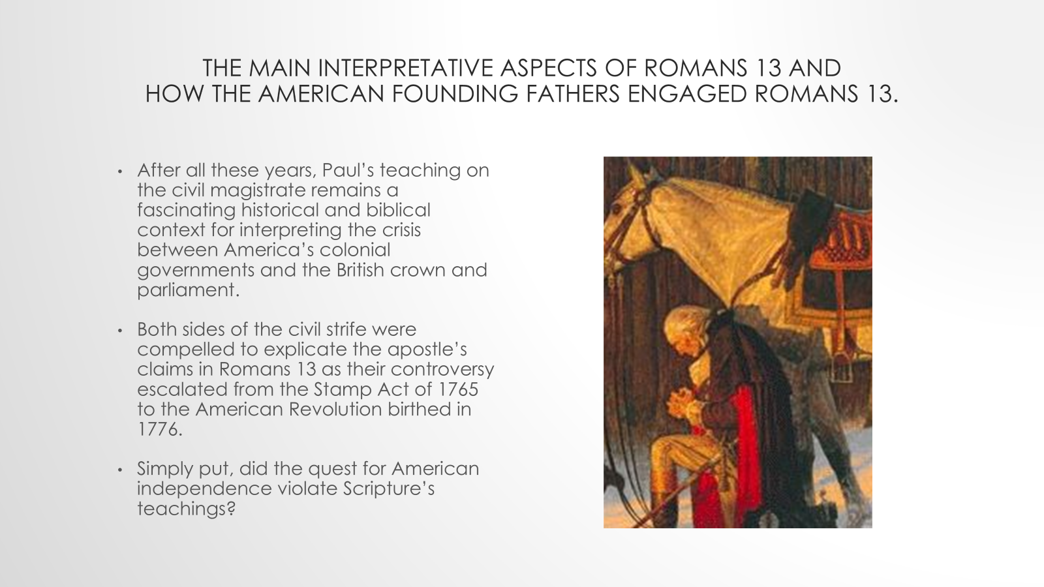

Slide 8
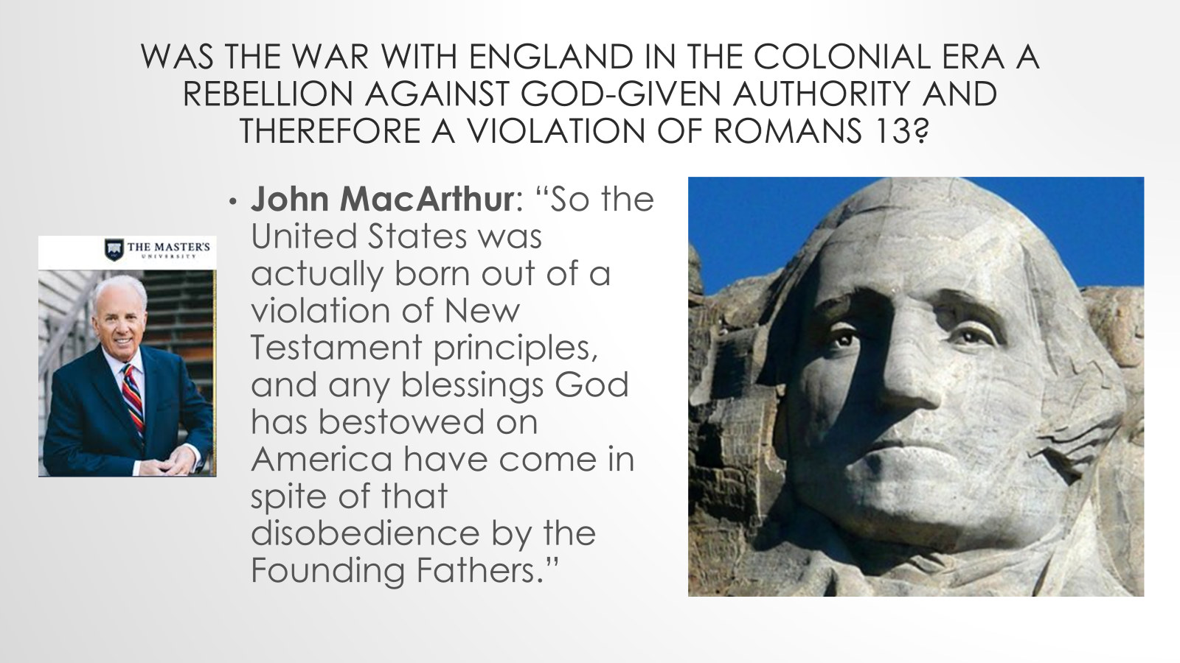

Slide 9
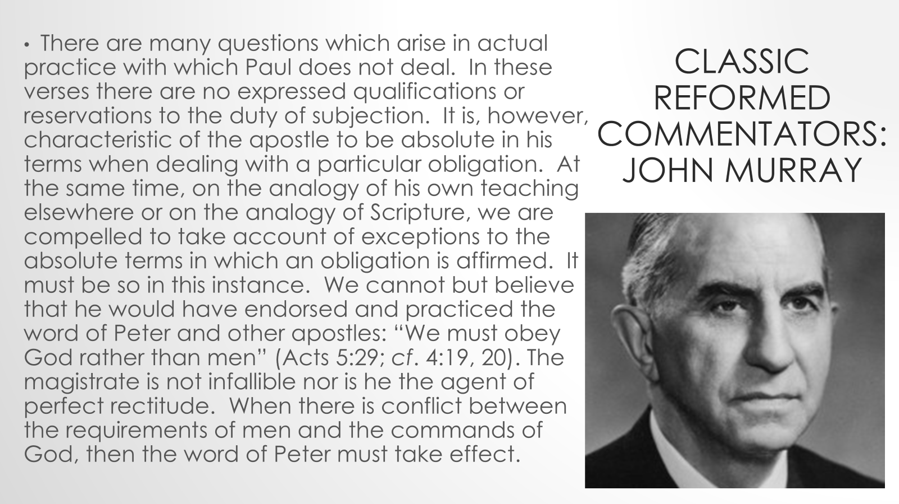

Slide 10
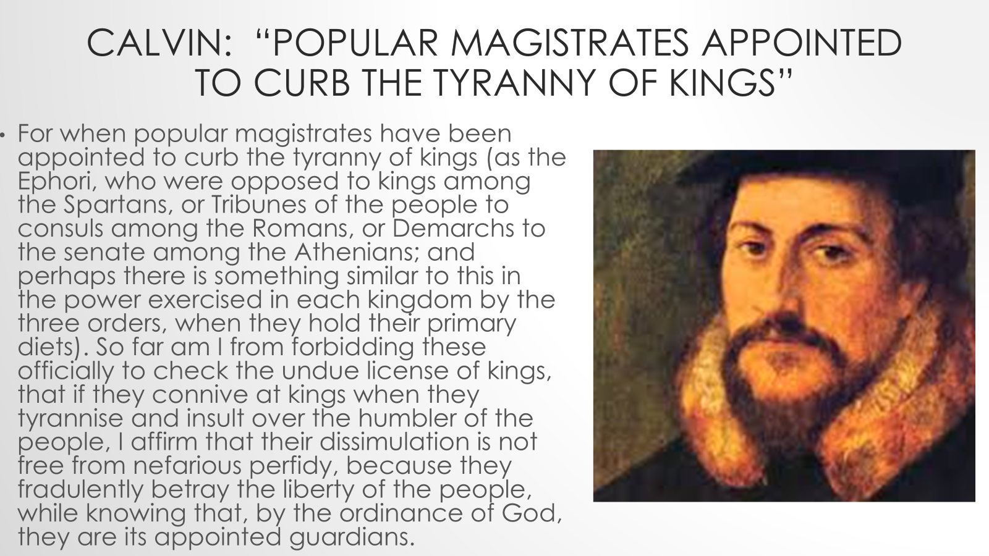

Slide 11
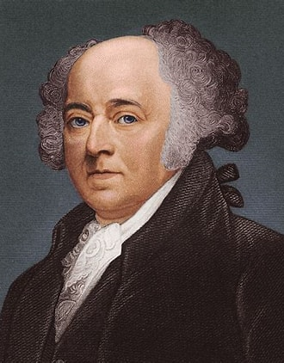
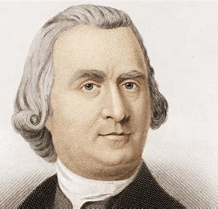
Opening in prayer at the first continental congress?
Samuel Adams—”I am no bigot. I can pray with any man who loves his God and his country.”
John Adam’s letter home to Abigail Adams about the opening prayer by Congress in Carpenter’s Hall.

Slide 12

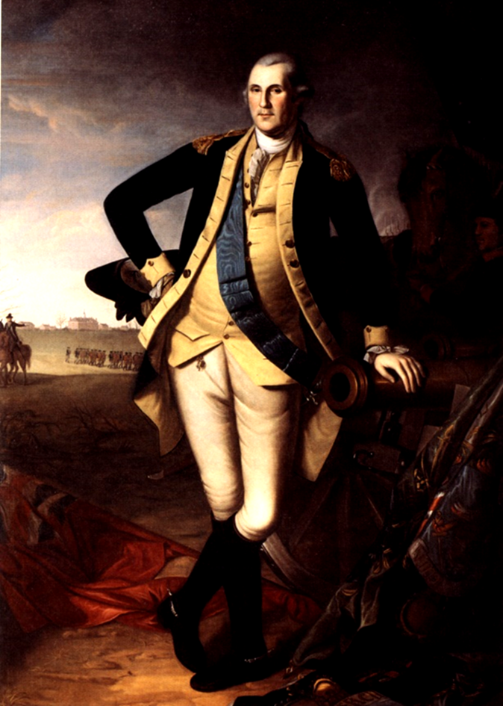
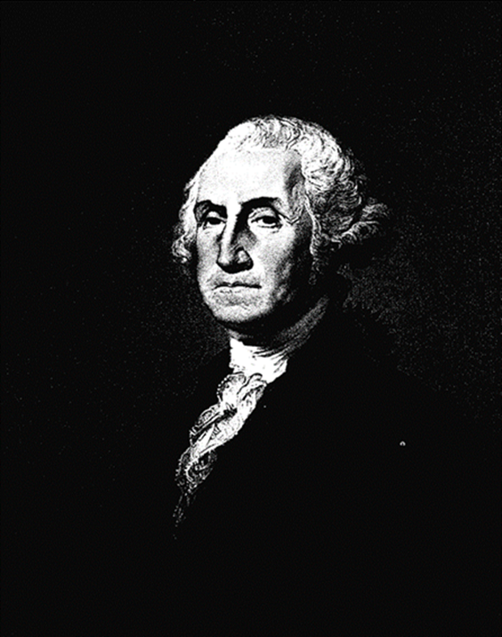
The Public witness of general and president
George Washington
General Washington
President Washington
“Unless we imitate the Author of our blessed Religion, we can never hope to be a happy nation.”
“Religion and morality are indispensable supports for our political prosperity.”

Slide 13
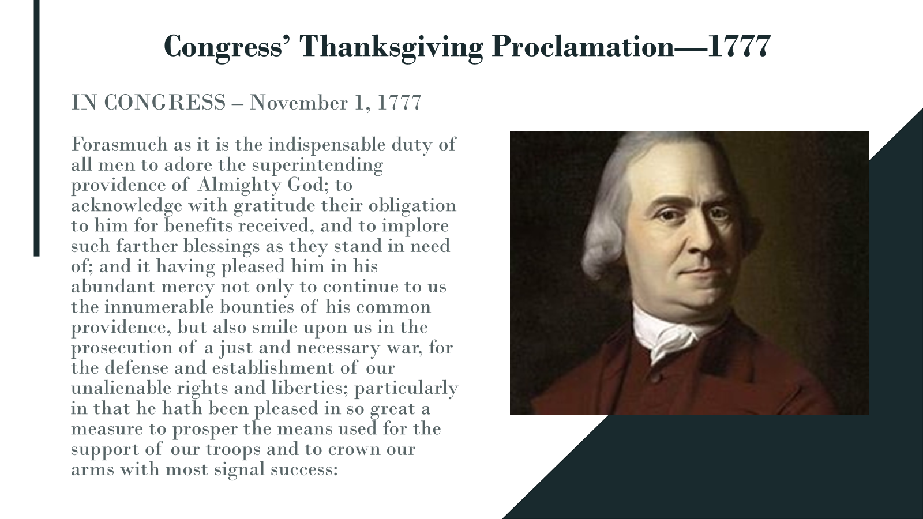
Customize this Template
Template Editing Instructions and Feedback

Slide 14
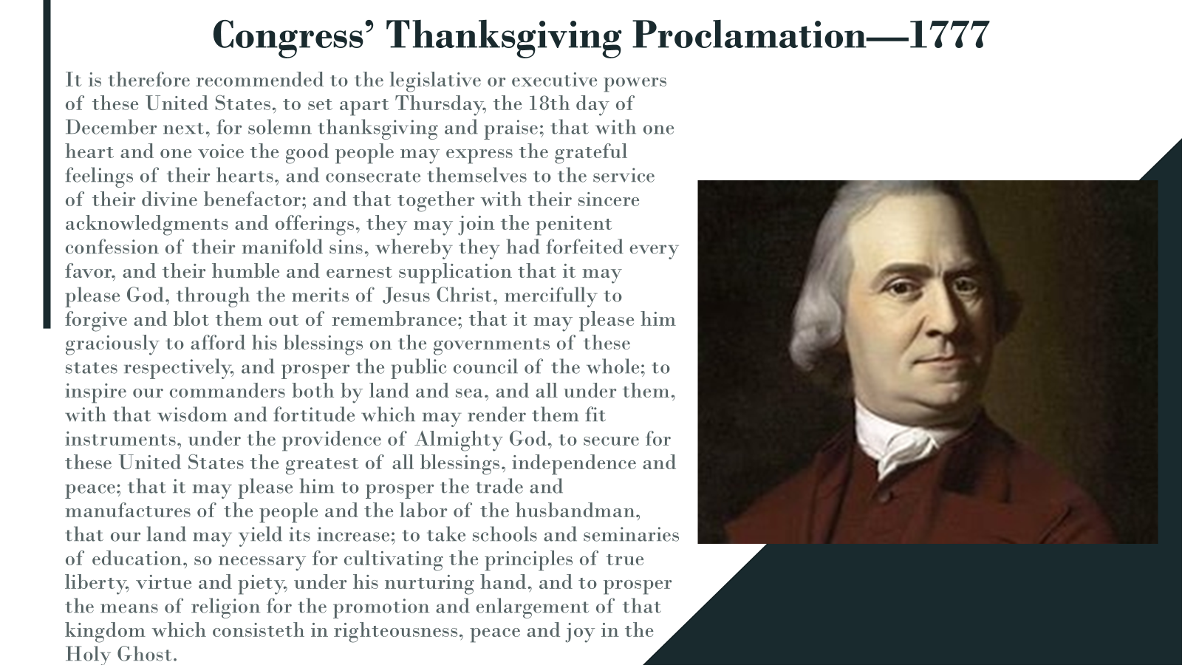
Customize this Template
Template Editing Instructions and Feedback

Slide 15
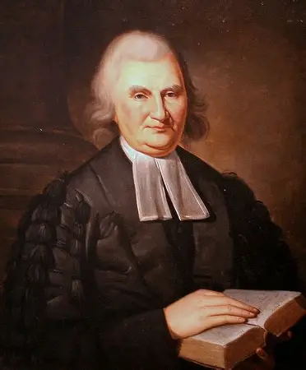
Princeton’s public theologian rev. dr. john witherspoon—
”The Dominion of providence over the passions of men”
“SUFFER me to beseech you, …. There can be no true religion, till there be a discovery of your lost state by nature and practice, and an unfeigned acceptance of Christ Jesus, as he is offered in the gospel. Unhappy they who either despise his mercy, or are ashamed of his cross! Believe it, there is no salvation in any other. There is no other name under heaven given among men by which we must be saved. Unless you are united to him by a lively faith, not the resentment of a haughty (19) monarch, but the sword of divine justice hangs over you, and the fulness of divine vengeance shall speedily overtake you. I do not speak this only to the heaven-daring profligate, or grovelling sensualist, but to every insensible secure sinner; to all those however decent and orderly in their civil deportment, who live to themselves, and have their part and portion in this life; in fine, to all who are yet in a state of nature, for except a man be born again, he cannot see the kingdom of God. …but nothing less than the sovereign grace of God can produce a saving change of heart and temper, or fit you for his immediate presence.” His Sermon before going to congress to vote for independence.

Slide 16

There are four references to God in the declaration of independence
“Endowed by our Creator with certain unalienable rights”
“The Laws of Nature and of Nature’s God”
“The Supreme Judge of the World”
“And with a firm reliance on the protection of divine providence, we mutually pledge to one another our lives, our fortunes, and our sacred honor”

Slide 17
Our forefathers threw off the yoke of Popery in religion; for you is reserved the honor of leveling the popery of politics. They opened the Bible to all, and maintained the capacity of every man to judge for himself in religion. …
Heaven hath trusted us with the management of things for eternity, and man denies us ability to judge of the present, or to know from our feelings the experience that will make us happy.
Samuel Adams was selected to explain why the Congress had voted for independence on August 1, the day before Congress would sign the document that they had voted for on July 2, 1776, a month before. He spoke on the steps of what we call today, Independence Hall.

Slide 18
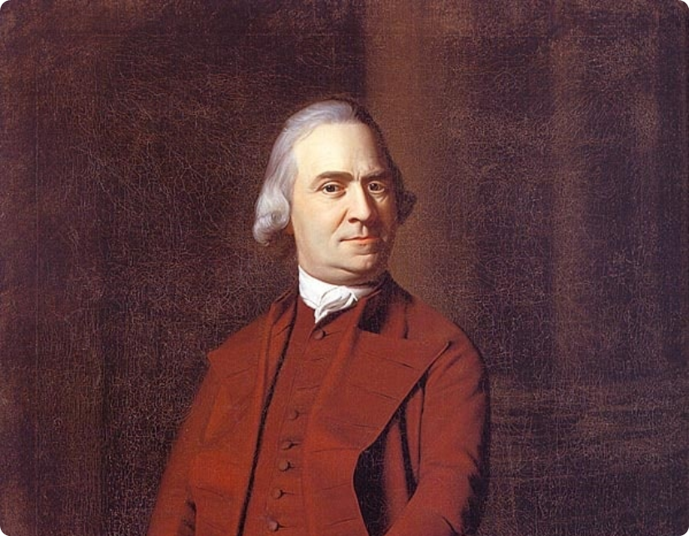
"This day, I trust, the reign of political protestantism will commence. We have explored the temple of royalty, and found that the idol we have bowed down to has eyes which see not, ears that hear not our prayers, and a heart like the nether millstone.
We have this day restored the Sovereign to whom alone men ought to be obedient. He reigns in Heaven, and with a propitious eye beholds his subjects assuming that freedom of thought and dignity of self-direction which he bestowed on them. From the rising to the setting sun, may his kingdom come!”
Samuel Adams Continued:

Slide 19
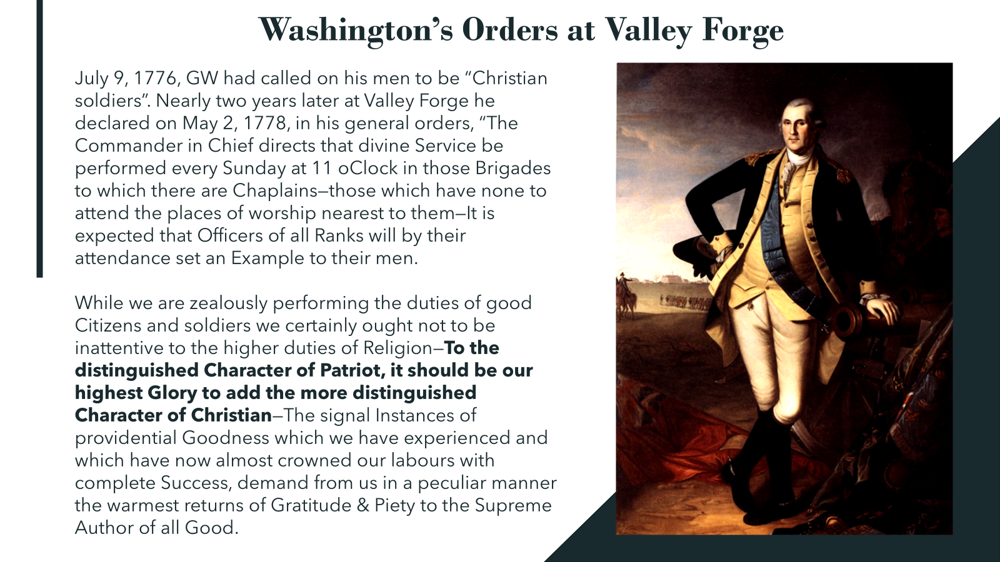
The Public witness of general and president
George Washington
General Washington
President Washington
“Unless we imitate the Author of our blessed Religion, we can never hope to be a happy nation.”
“Religion and morality are indispensable supports for our political prosperity.”

Slide 20
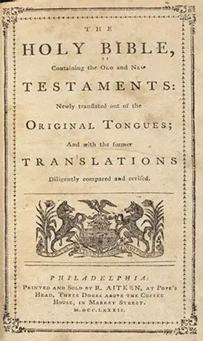
Congress’ Bible—1782
Cover page of The Aitken Bible

Slide 21
Congress’ Bible—1782—Robert Aitken’s bible
Congress gave Aitken a ringing endorsement in the form of a congressional resolution to “publish this Recommendation in the manner he shall think proper” to help sell and circulate the Bible. The complete text of this Congressional resolution is:
Whereupon,
RESOLVED,
THAT the United States in Congress assembled highly approve the pious and laudable undertaking of Mr. Aitken, as subservient to the interest of religion, as well as an instance of the progress of arts in this country, and being satisfied from the above report of his care and accuracy in the execution of the work, they recommend this edition of the Bible to the inhabitants of the United States, and hereby authorize him to publish this Recommendation in the manner he shall think proper.

Slide 22
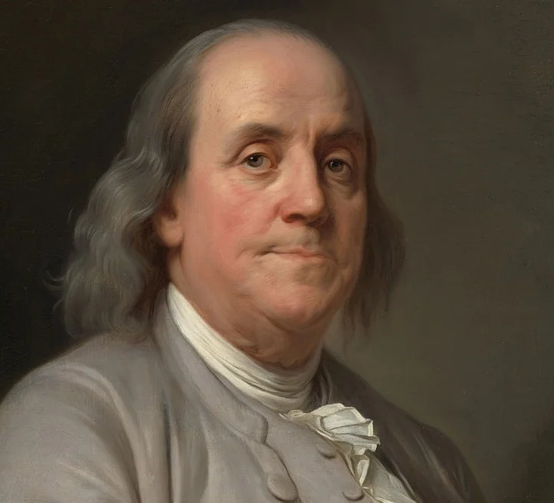
Benjamin franklin’s call for prayer at the constitutional convention
June 28, 1787

Slide 23
Mr. President:
The small progress we have made after four or five weeks close attendance & continual reasonings with each other—our different sentiments on almost every question, several of the last producing as many noes as ays, is methinks a melancholy proof of the imperfection of the Human Understanding.
We indeed seem to feel our own want of political wisdom, since we have been running about in search of it.
We have gone back to ancient history for models of Government, and examined the different forms of those Republics which having been formed with the seeds of their own dissolution now no longer exist. And we have viewed Modern States all round Europe, but find none of their Constitutions suitable to our circumstances.

Slide 24
In this situation of this Assembly, groping as it were in the dark to find political truth, and scarce able to distinguish it when presented to us, how has it happened, Sir, that we have not hitherto once thought of humbly applying to the Father of lights to illuminate our understandings? In the beginning of the Contest with Great Britain, when we were sensible of danger we had daily prayer in this room for the divine protection. Our prayers, Sir, were heard, & they were graciously answered.
All of us who were engaged in the struggle must have observed frequent instances of a superintending providence in our favor. To that kind providence we owe this happy opportunity of consulting in peace on the means of establishing our future national felicity. And have we now forgotten that powerful friend? Or do we imagine that we no longer need his assistance?

Slide 25
I have lived, Sir, a long time, and the longer I live, the more convincing proof I see of this truth that God Governs in the affairs of men. And if a sparrow cannot fall to the ground without his notice, is it probable that an empire can rise without his aid?
We have been assured, Sir, in the sacred writings, that “except the Lord build the House they labour in vain that build it.” I firmly believe this; and I also believe that without his concurring aid we shall succeed in this political building no better, than the Builders of Babel: We shall be divided by our little partial local interests; our projects will be confounded, and we ourselves shall become a reproach and bye word down to future ages. And what is worse, mankind may hereafter from this unfortunate instance, despair of establishing Governments by Human wisdom and leave it to chance, war and conquest.

Slide 26
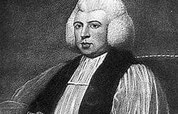
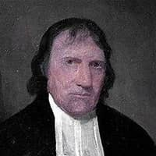
I therefore beg leave to move-that henceforth prayers imploring the assistance of Heaven, and its blessings on our deliberations, be held in this Assembly every morning before we proceed to business, and that one or more of the Clergy of this City be requested to officiate in that Service.
President Washington was inaugurated for the first time on April 30, 1789.
Five days before his inauguration, the first chaplain of the US Senate was approved (April 25, 1789), electing the Right Rev. Samuel Provoost, the Episcopal chaplain of New York.
The day following Washington’s inauguration, May 1, 1789, Presbyterian Minister Rev. William Linn was elected as the Chaplan of the US House of Representatives.
Both houses continue to open with prayer and have had a chaplain lead in prayer since 1789.

Slide 27
The constitutional Convention
The Preamble
Checks and Balances—Human Depravity
“Sundays excepted”
Provision to affirm rather than an oath.
Concluding Date Unanimously Affirmed, “In the Year of Our Lord, 1787”

Slide 28
Consider the biblical values of the preamble of the Us Constitution
1. We the People of the United States = Unity and Community. Psalm 133:1.
2. In Order to Form a More Perfect Union = Realistic, not Utopian. Psalm 119:96.
3. Establish Justice, = “Do justice, love mercy, walk humbly.” Micah 6:8.
4. Insure Domestic Tranquility, = “Live at peace with all men.” Romans 12:18.
5. Provide for the Common Defense, = “Defend the weak and fatherless.” Psalm 82:3.
6. Promote the General Welfare, = “Do good to all men.” Galatians 6:10.
7. And Secure the Blessings of Liberty, = “Proclaim Liberty.” Leviticus 25:10. (Liberty Bell.)
8. To Ourselves and to Our Posterity, = “To us and to our children.” (Covenant) Genesis 17:7.
9. Do Ordain and Do Establish, = “Do all things decently and in order.” 1 Corinthians 14:40.
10. This Constitution of the United States of America, = an afortiori as God Himself Had a Constitution in the giving of Deuteronomy.

Slide 29
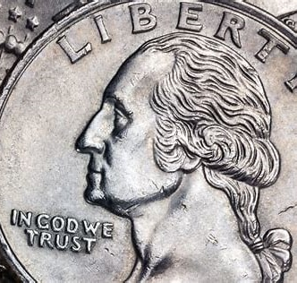
is there an “official” American theology?
1. God is over the Nation—”One nation under God”. (Pledge of Allegiance.)
2. God is Creator—”Endowed by our Creator”. (Declaration of Independence.)
3. Rights are from God—”Endowed by our Creator with certain unalienable rights.” (D.I.)
4. God is a Law-Giver—”the laws of nature and of nature’s God”. (D.I.)
5. God is Supreme Judge—”appealing to the Supreme Judge of the world for the rectitude of our intentions.” (D.I.)
6. God governs in the affairs of men—”With a firm reliance on the protection of divine providence.” (D.I.)
7. Self Government under God—“Religion and Morality are indispensable supports for political prosperity.” (President George Washington and President John Adams.)
8. Purpose for America—“Blessings of Liberty” see the biblical values listed in the Preamble of the Constitution.
9. God is to be trusted—”In God We Trust” (The National Motto.)
10. “Imitate the Divine Author of our blessed Religion”—General George Washington .

Slide 30
The Logic of liberty
Do you want to be free? You need a Republic.
Do you want a Republic? You need a Constitution.
Do you want a Constitution? You need Moral People.
Do you want Moral People? You need religion.
Washington’s Farewell Address, “Religion and Morality are indispensable supports for our political prosperity.”

Slide 31
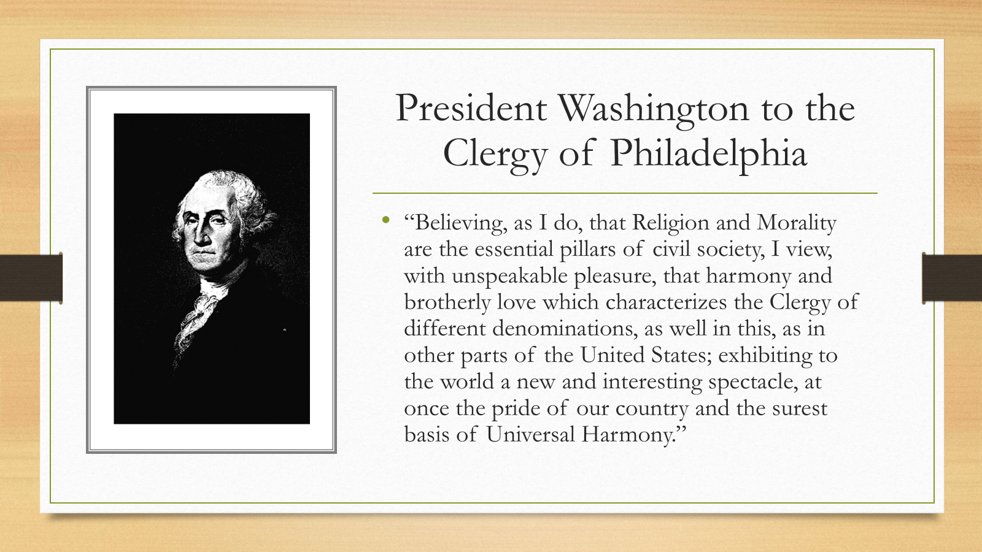

Slide 32
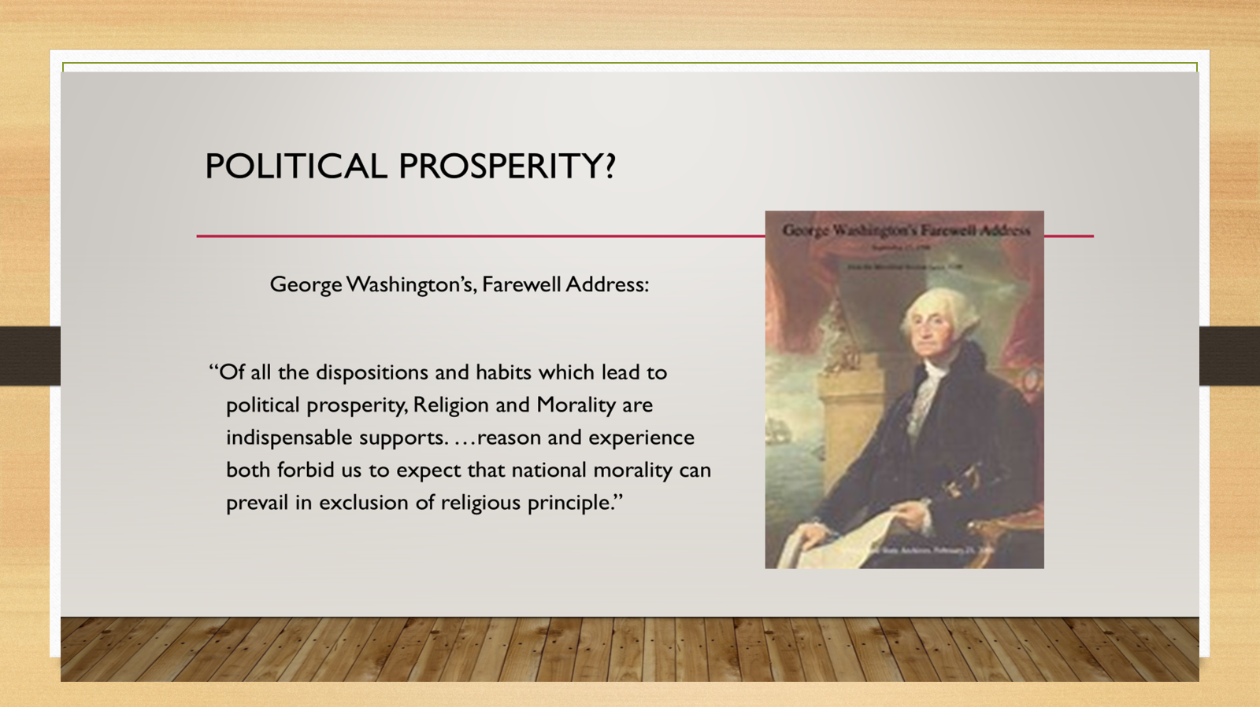

Slide 33
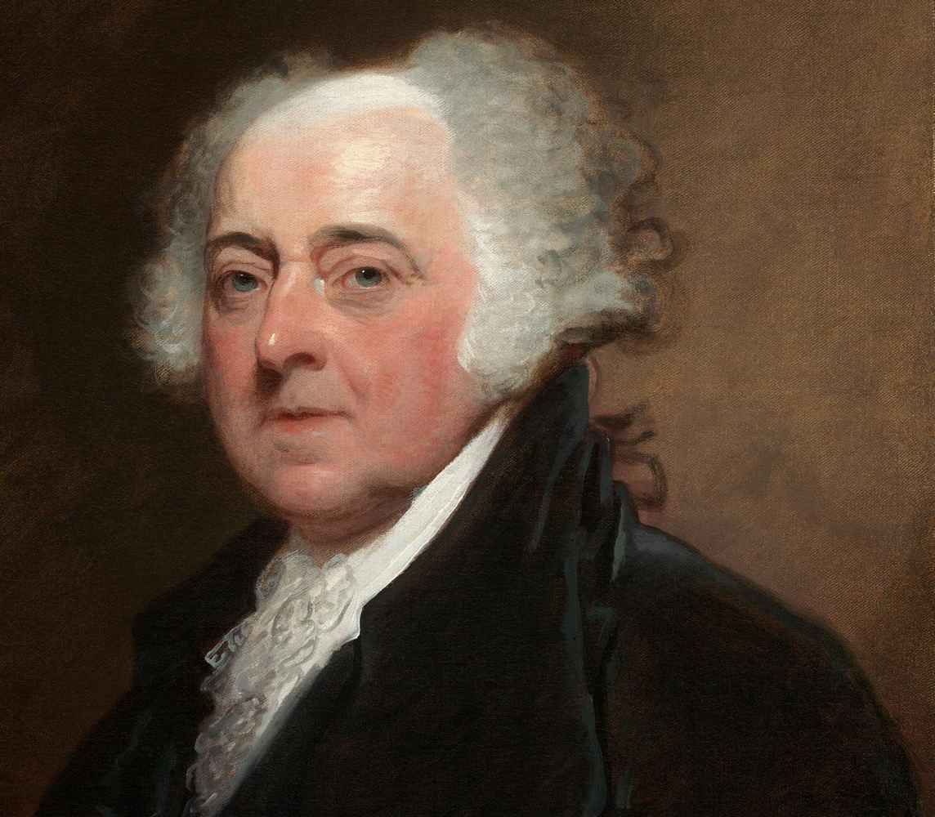
From (President) John Adams to Massachusetts Militia, 11 October 1798
To the Officers of the first Brigade of the third
Division of the Militia
of Massachusetts
Quincy October 11. 1798
Gentlemen
I have received from Major General Hull and Brigadier General Walker your unanimous Address from Lexington, animated with a martial Spirit and expressed with a military Dignity, becoming your Characters and the memorable Plains, in which it was adopted.
While our Country remains untainted with the Principles and manners, which are now producing desolation in so many Parts of the World: while she continues Sincere and incapable of insidious and impious Policy: We shall have the Strongest Reason to rejoice in the local destination assigned Us by Providence. But should the People of America, once become capable of that deep simulation towards one another and towards foreign nations, which assumes the Language of Justice and moderation while it is practicing Iniquity and Extravagance; and displays in the most captivating manner the charming Pictures of Candour frankness & sincerity while it is rioting in rapine and Insolence: this Country will be the most miserable Habitation in the World.

Slide 34
Because We have no Government armed with Power capable of contending with human Passions unbridled by morality and Religion. Avarice, Ambition, Revenge or Galantry, would break the strongest Cords of our Constitution as a Whale goes through a Net. Our Constitution was made only for a moral and religious People. It is wholly inadequate to the government of any other.
An Address so unanimous and firm from the officers commanding two thousand Eight hundred Men, consisting of such substantial Citizens as are able and willing at their own Expence, compleatly to arm, And cloath themselves in handsome Uniforms does honor to that Division of the Militia which has done so much honor to their Country. Oaths, in this Country, are as yet universally considered as Sacred Obligations. That which you have taken and so solemnly repeated on that venerable Spot is an ample Pledge of your sincerity, and devotion to your Country and its Government.
John Adams

Slide 35
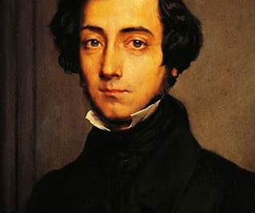
Alexis de toqueville (1805-1859)
“It is religion which has given birth to Anglo-American societies; one must never lose sight of that; in the United States religion is thus intimately linked to all national habits and all the emotions which one’s native country arouses; that gives it a particular strength…. Christianity has therefore maintained a strong sway over the American mind and—something I wish to note above all—it rules not only like a philosophy taken up after evaluation but like a religion believed without discussion. In the United States, Christian sects are infinitely varied and are endlessly modified, while Christianity itself is an established and unassailable fact which no one undertakes either to attack or defend. The Americans, have accepted without question the main teachings of the Christian religion, are obliged to accept in the same way a great number of moral truths which derive from it and hold it together.” (Democracy in America.)

Slide 36
